Slide 1
Prefix Sums

Slide 2
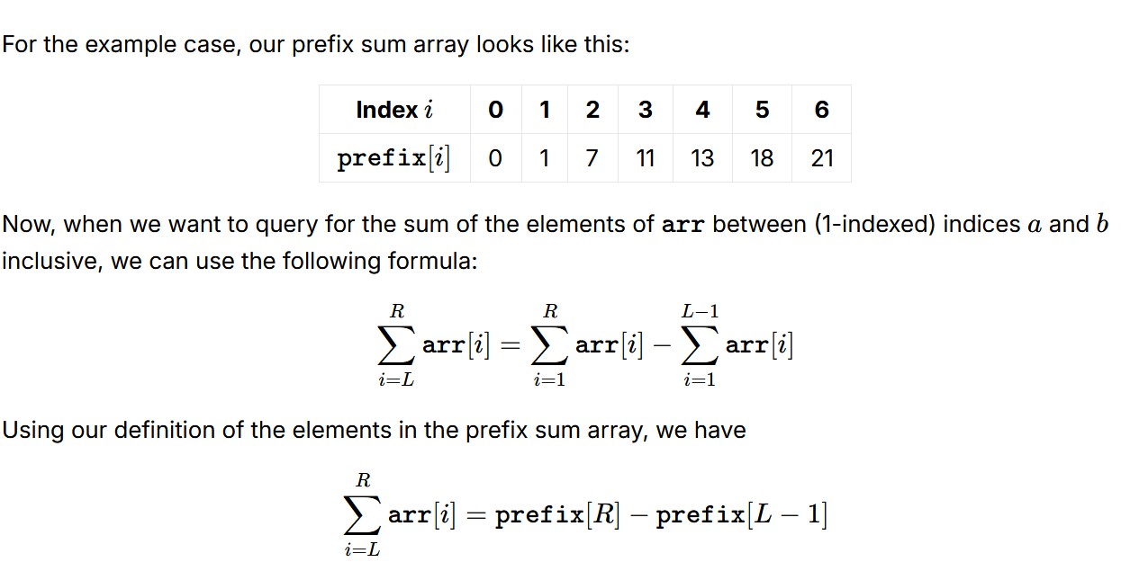

Slide 3
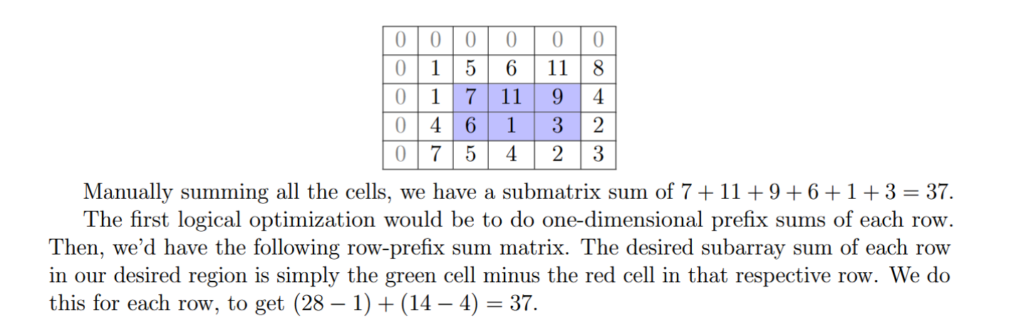

Slide 4
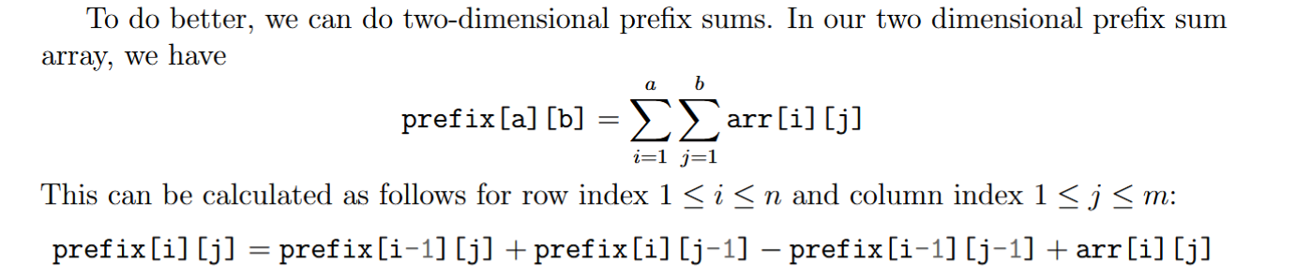

Slide 5
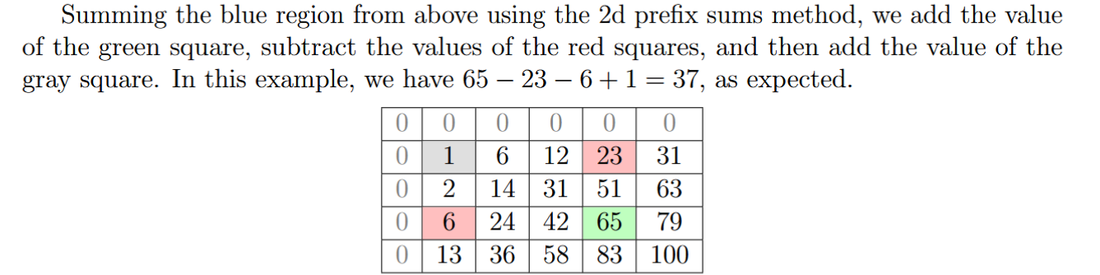

Slide 6
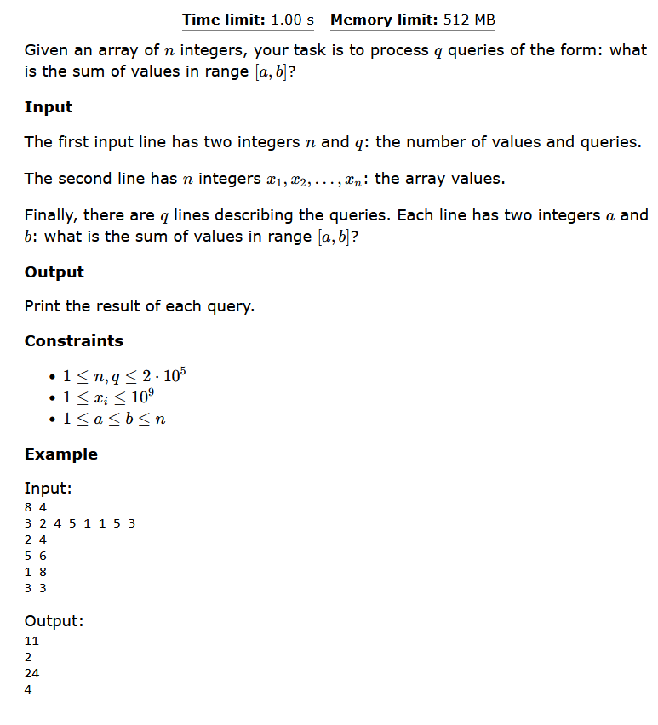

Slide 7
#include<bits/stdc++.h>
using namespace std;
typedef long long int ll;
int main(){
int n,q; cin >> n >> q;
vector<ll> v(n);
for(int i = 0; i<n; i++){
cin >> v[i];
}
//counting prefix sum
for(int i = 1; i<n; i++)v[i]+=v[i-1];
while(q--){
int l ,r ;
cin >> l >> r;
l--, r--;
if(l==0){
cout << v[r]<< "\n";
continue;
}
cout << v[r]-v[l-1] << "\n";
}
}
//https://cses.fi/problemset/task/1646

Slide 8
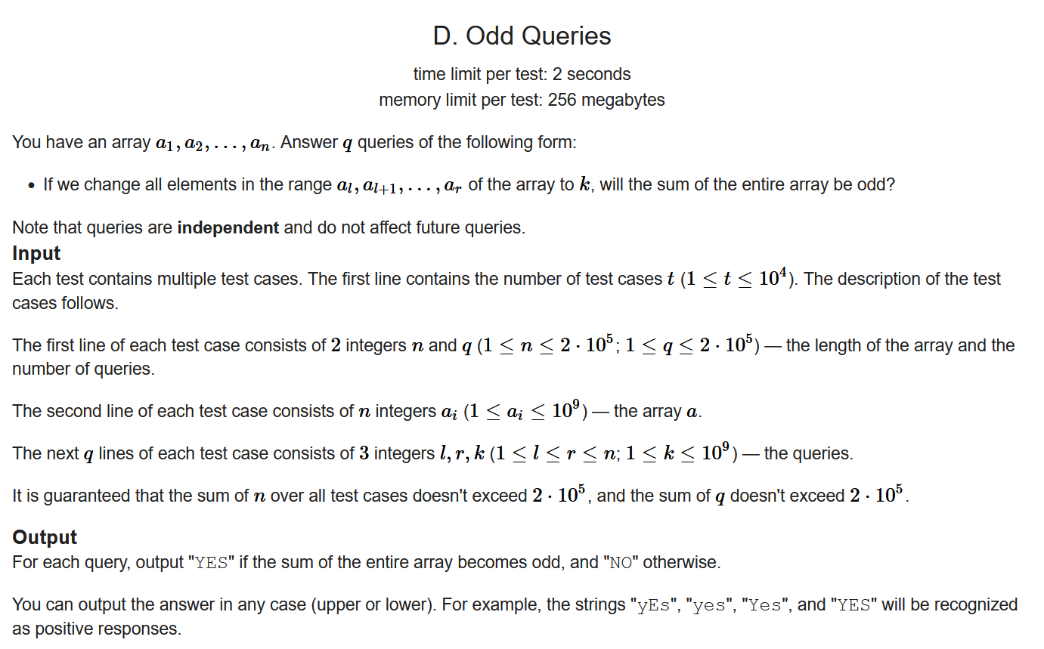

Slide 9
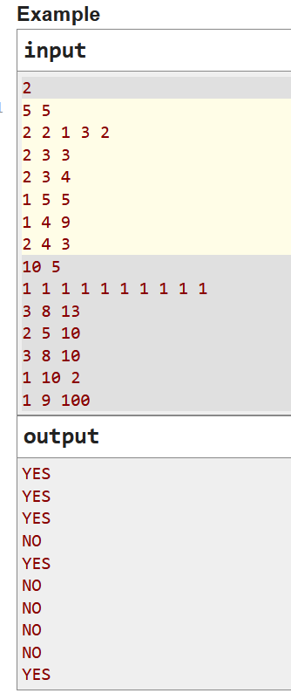
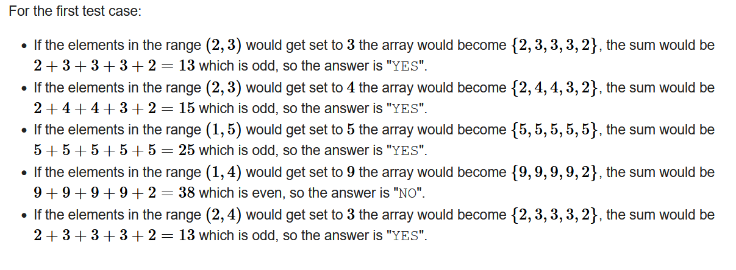

Slide 10
#include<bits/stdc++.h>
using namespace std;
typedef long long int ll;
void solve(){
int n,q; cin >> n >> q;
vector<ll> v(n);
for(int i = 0; i<n; i++){
cin >> v[i];
}
//counting prefix sum
for(int i = 1; i<n; i++)v[i]+=v[i-1];
while(q--){
int l,r,k; cin >> l >> r >> k ;
l--, r--;
unsigned long long int sum;
if(l==0 && r==n-1){
sum = k*n;
}
else if(l==0){
sum = v[n-1]-v[r]+k*(r+1);
}else if(r==n-1){
sum = v[l-1]+k*(n-l);
}
else{
sum = v[l-1]+v[n-1]-v[r]+k*(r-l+1);
}
if(sum%2==1)cout << "Yes" << "\n";
else cout << "No" << "\n";
}
}
int main(){
ios_base::sync_with_stdio(false);
cin.tie(0);
int t; cin >> t;
while(t--)solve();
}

Slide 11
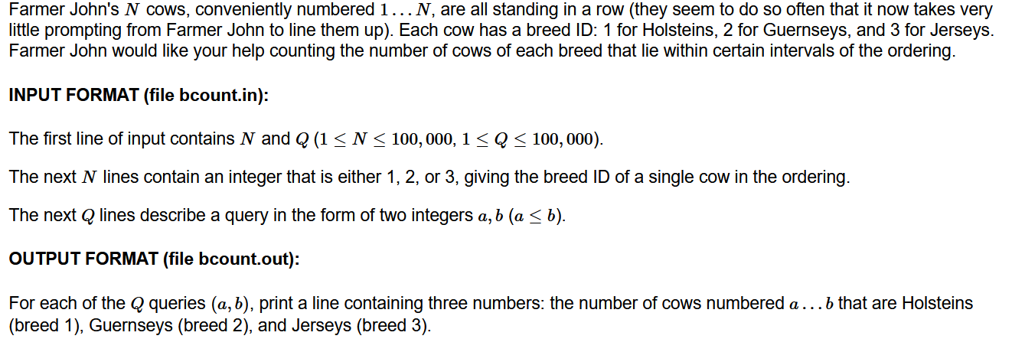
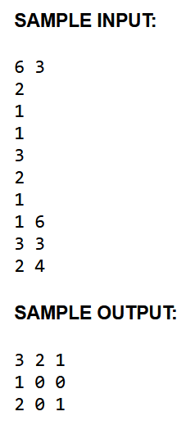

Slide 12
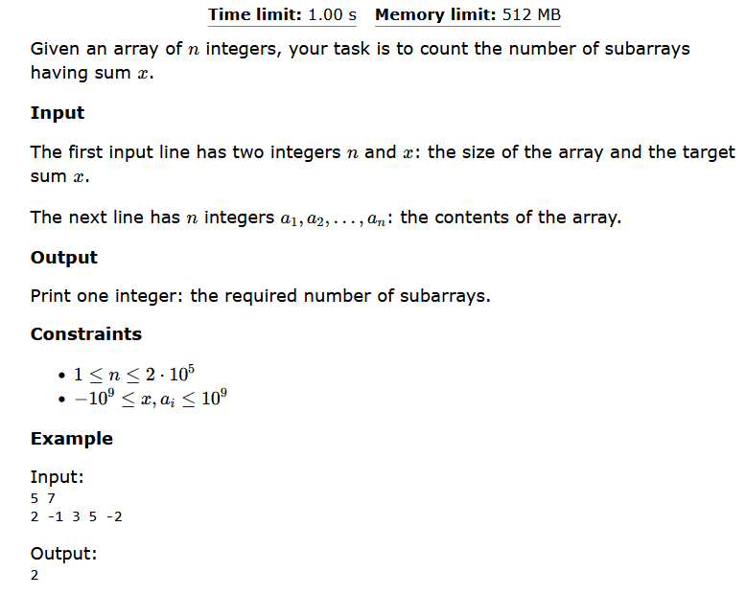

Slide 13
#include<bits/stdc++.h>
using namespace std;
typedef long long int ll;
void solve(){
ll n, x; cin >> n >>x;
vector<ll> v(n), t(n);
map<ll,ll> m;
for(int i = 0; i<n; i++){
cin >> v[i];
}
//counting prefix sum
for(int i = 1; i<n; i++)v[i]+=v[i-1];
for(int i = 0; i<n; i++)t[i]=v[i]-x;
ll ans = 0;
m[v[0]]++;
//if(v[0]==x)ans++;
for(int i = 1; i<n; i++){
long long int to_find_x = t[i];
if(m.count(to_find_x)){
ans += m[to_find_x];
}
//update the frequency
m[v[i]]++;
}
for(int i = 0; i<n; i++){
if(t[i]==0)ans++;
}
cout << ans << "\n";
}
int main(){
//freopen("input.txt", "r", stdin);
ios_base::sync_with_stdio(false);
cin.tie(0);
int t=1;
while(t--)solve();
}

